Slide 1


Airline Safety
Incidents Rates & Impact on Sales

Slide 2
Airline Safety Under Attack
PROBLEM: Recent crashes have caused the media to focus on airline safety. However, the statistics they have provided to the public are inaccurate and do not portray the entire picture.
SOLUTION: Airline executives need to fightback and provide real statistics to the public that prove the airline industry is continues to be one of the safest modes of transportation.

Slide 3
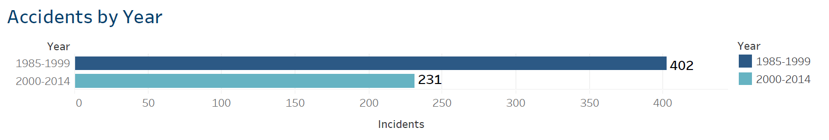
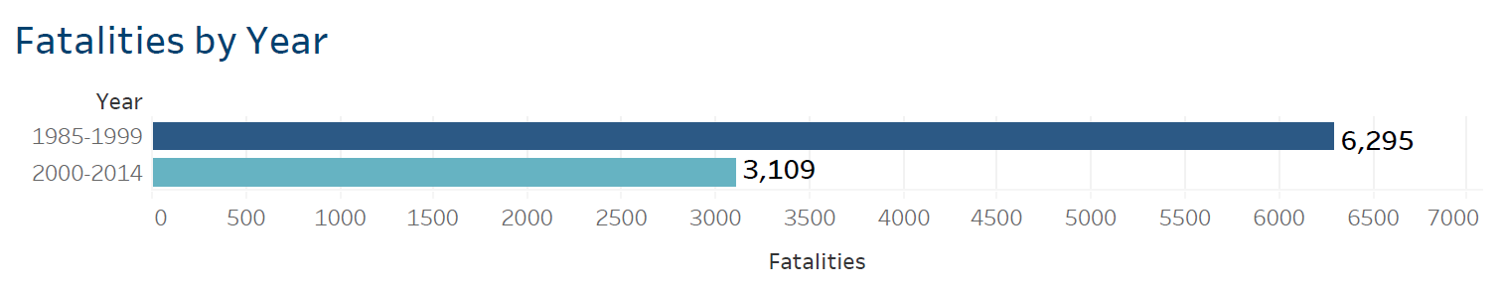
Airline Industry Totals 1985 - 2014

Slide 4
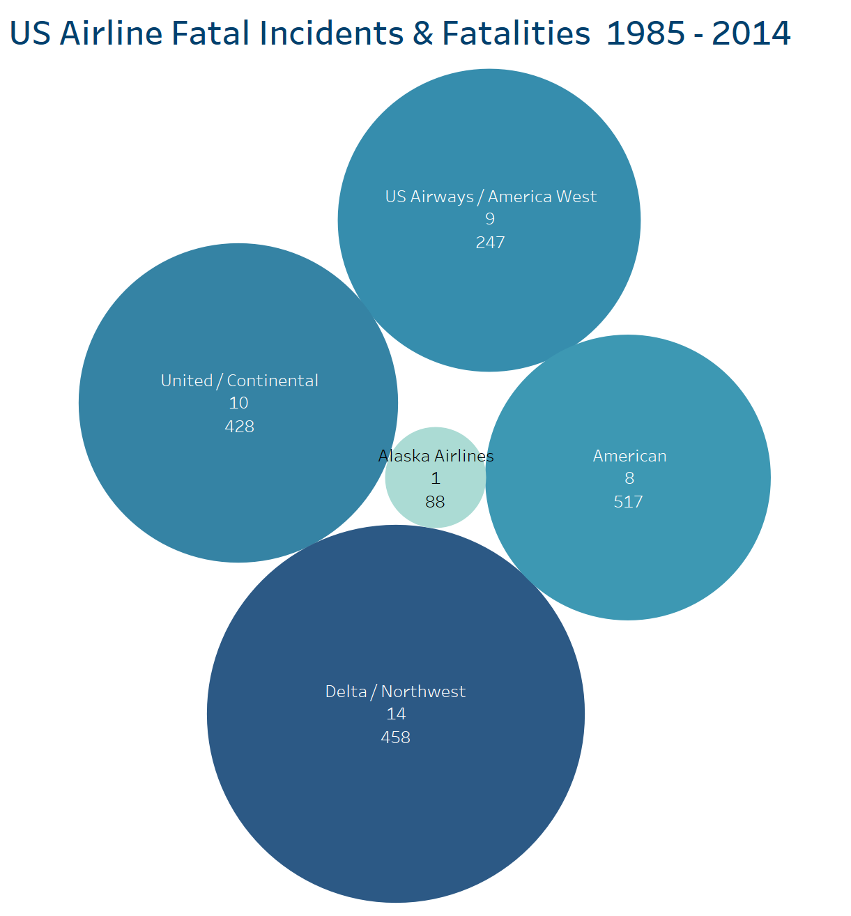
Where We Stand in the US Market
Alaska Airlines:
10 Incidents
1 fatal accident
88 Deaths

Slide 5

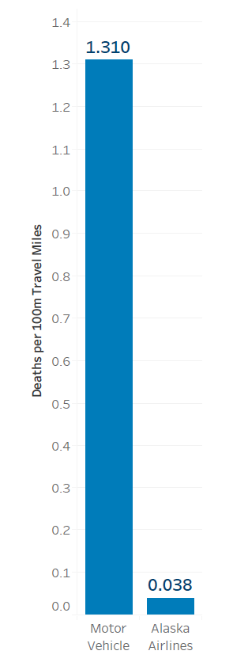

Average Deaths per 100 million Travel Miles
Motor Vehicle 1.310 per million
Alaska Airlines 0.038 per million
You are more likely to die in a motor vehicle than on Alaska Airlines!
34x

Slide 6
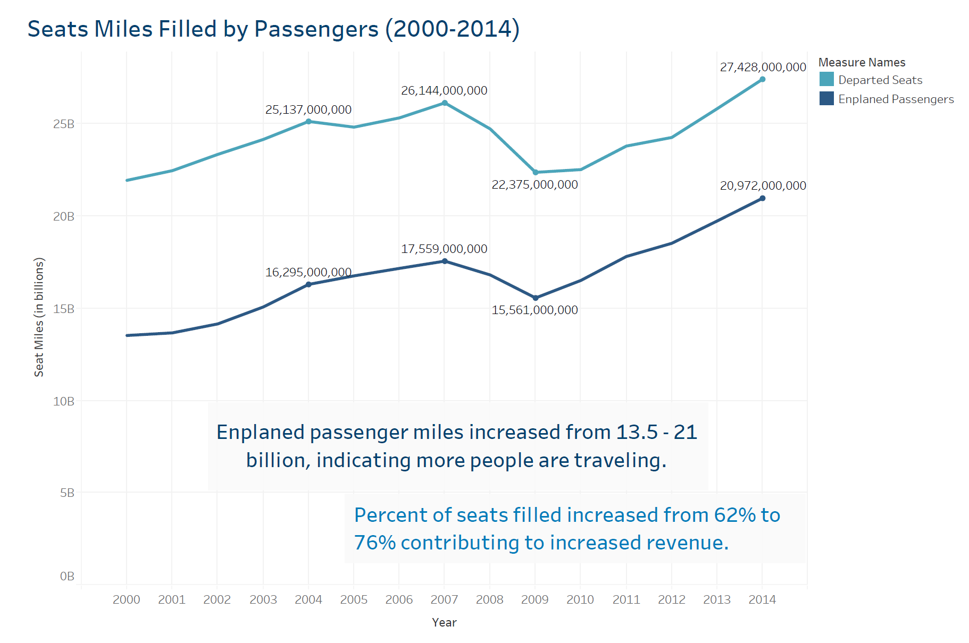
Are People Traveling Less on Alaska?

Slide 7
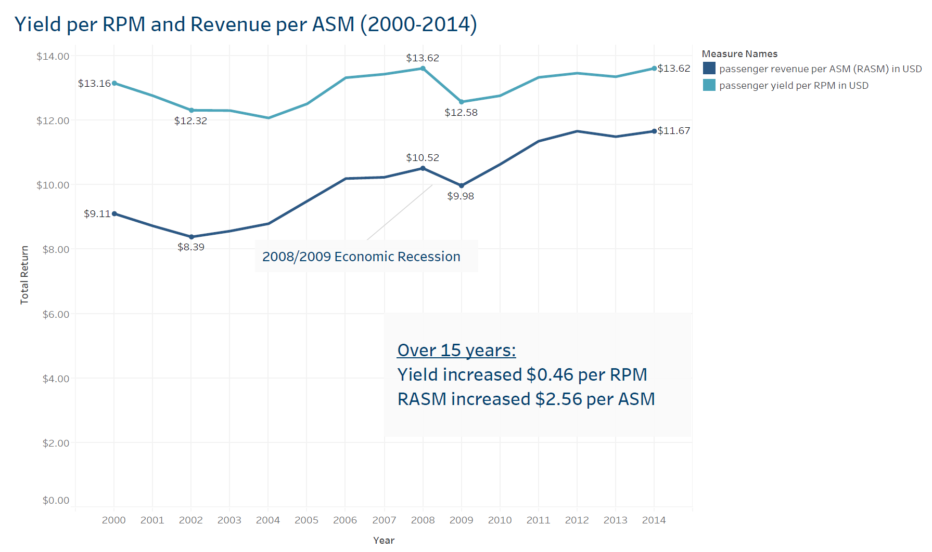
Alaska Airlines Revenue

Slide 8
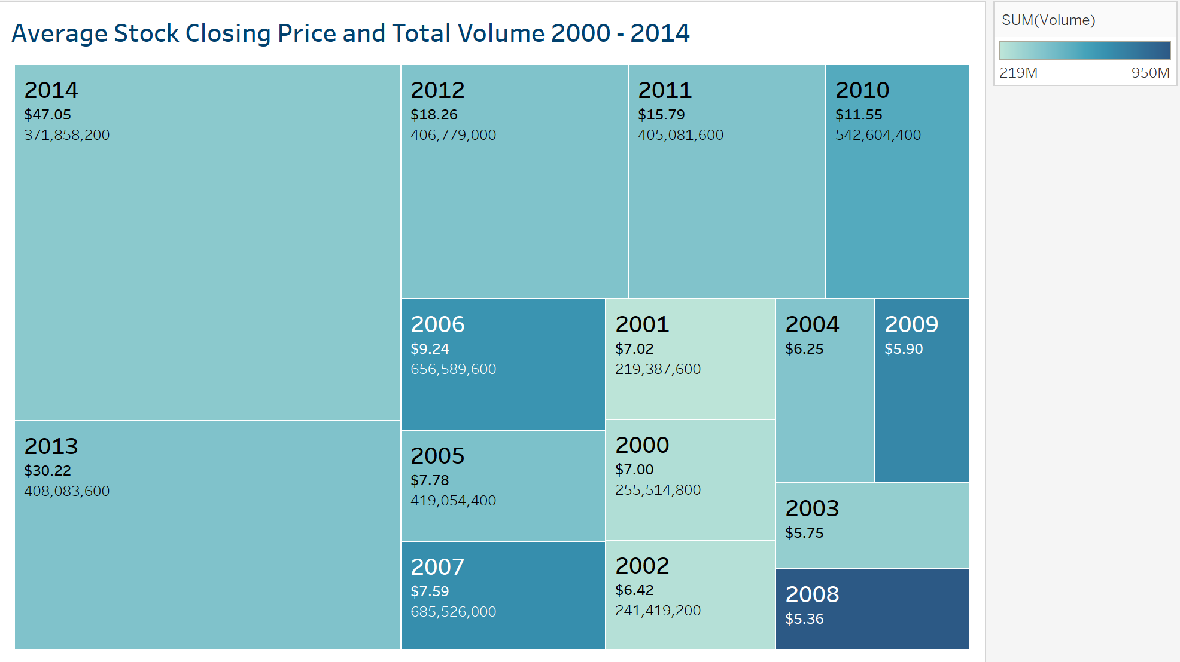
Alaska Airlines Stock Data

Slide 9
Conclusion
Airline incidents and fatalities have decreased over time.
Airline travel has far fewer fatalities overall than motor vehicles.
The airline industry and Alaska Airlines is thriving.
People are flying more.
Revenue and yield are trending upward.
Stock prices continue to rise.
Executives and public relations personnel can be confident in relaying this information to the public to mitigating damage to the reputation of the entire airline industry.

Slide 10
Data Sources
http://web.mit.edu/airlinedata/www/Traffic&Capacity.html
https://github.com/fivethirtyeight/data/tree/master/airline-safety
https://www-fars.nhtsa.dot.gov/Main/index.aspx
https://finance.yahoo.com/quote/ALK/history?p=ALK

